Slide 1
Faster R-CNN: Towards Real-Time Object Detection with Region Proposal Networks
Shaoqing Ren, Kaiming He, Ross Girshick, Jian Sun
Presented BY: Aditya Alif Nugraha

Slide 2
Introduction

Slide 3
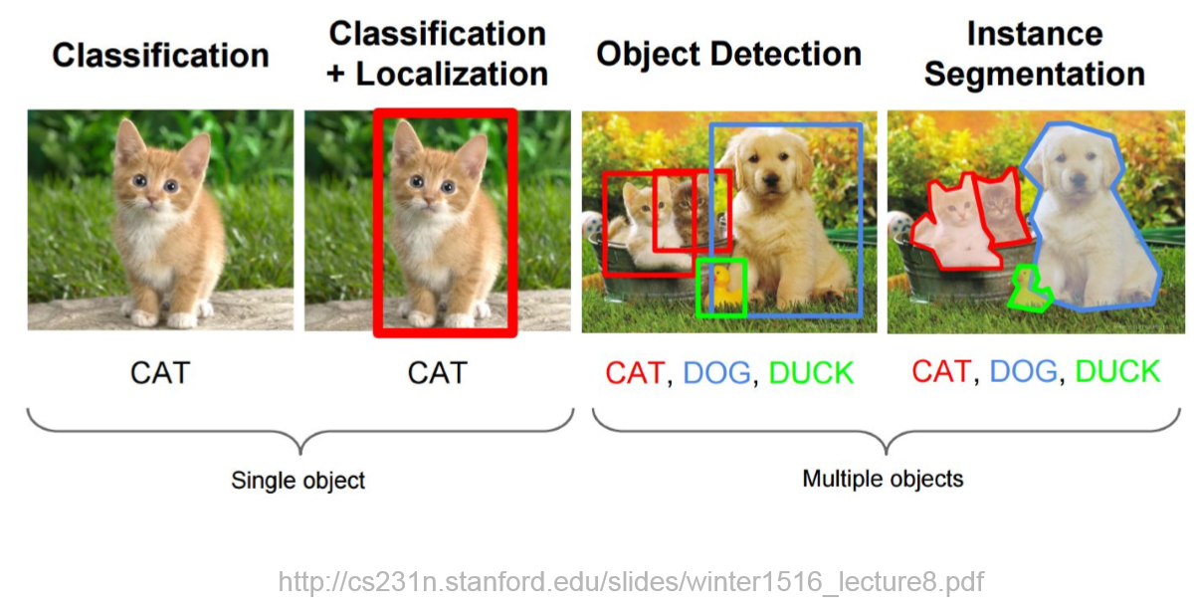
What is Object Detection?

Slide 4
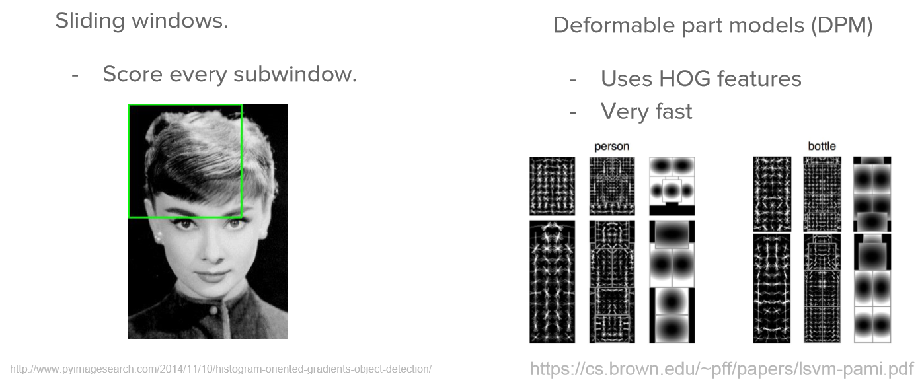
Before Deep Learning

Slide 5
R-CNN, Fast R-CNN, Faster R-CNN, Fastest R-CNN?

Slide 6
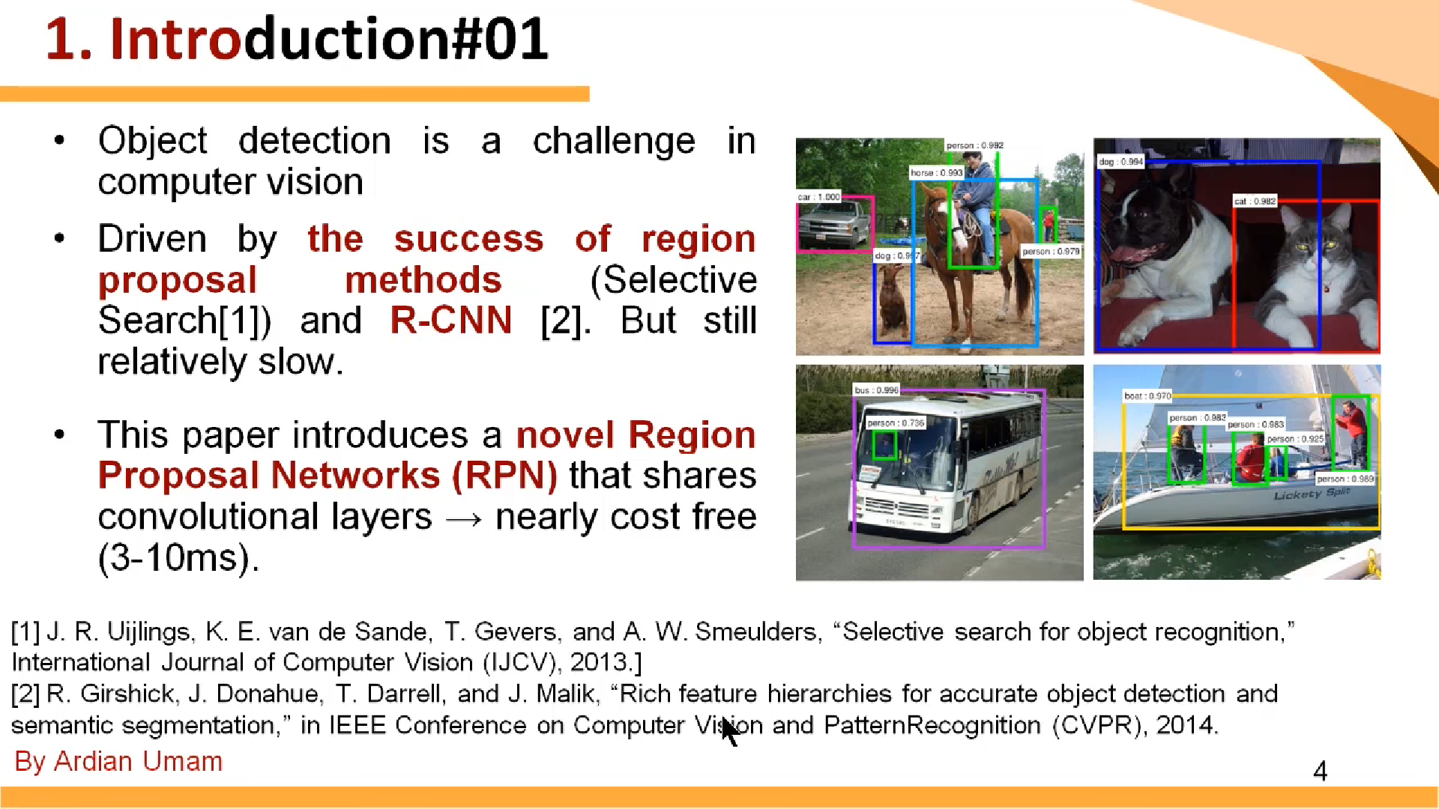

Slide 7
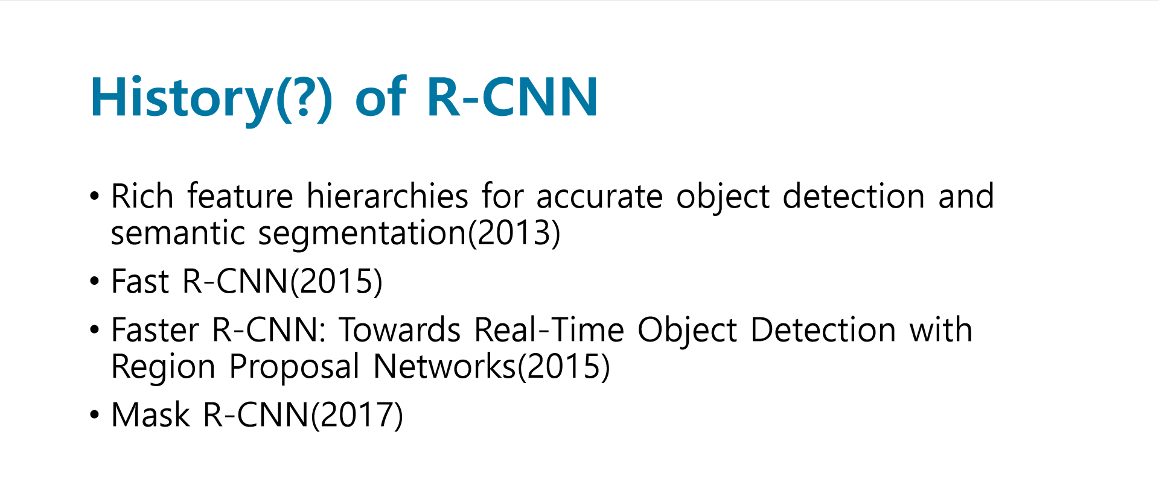

Slide 8
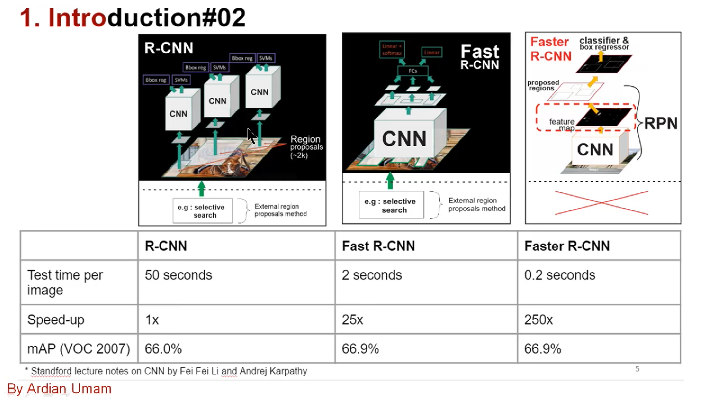

Slide 9
Faster R-CNN

Slide 10
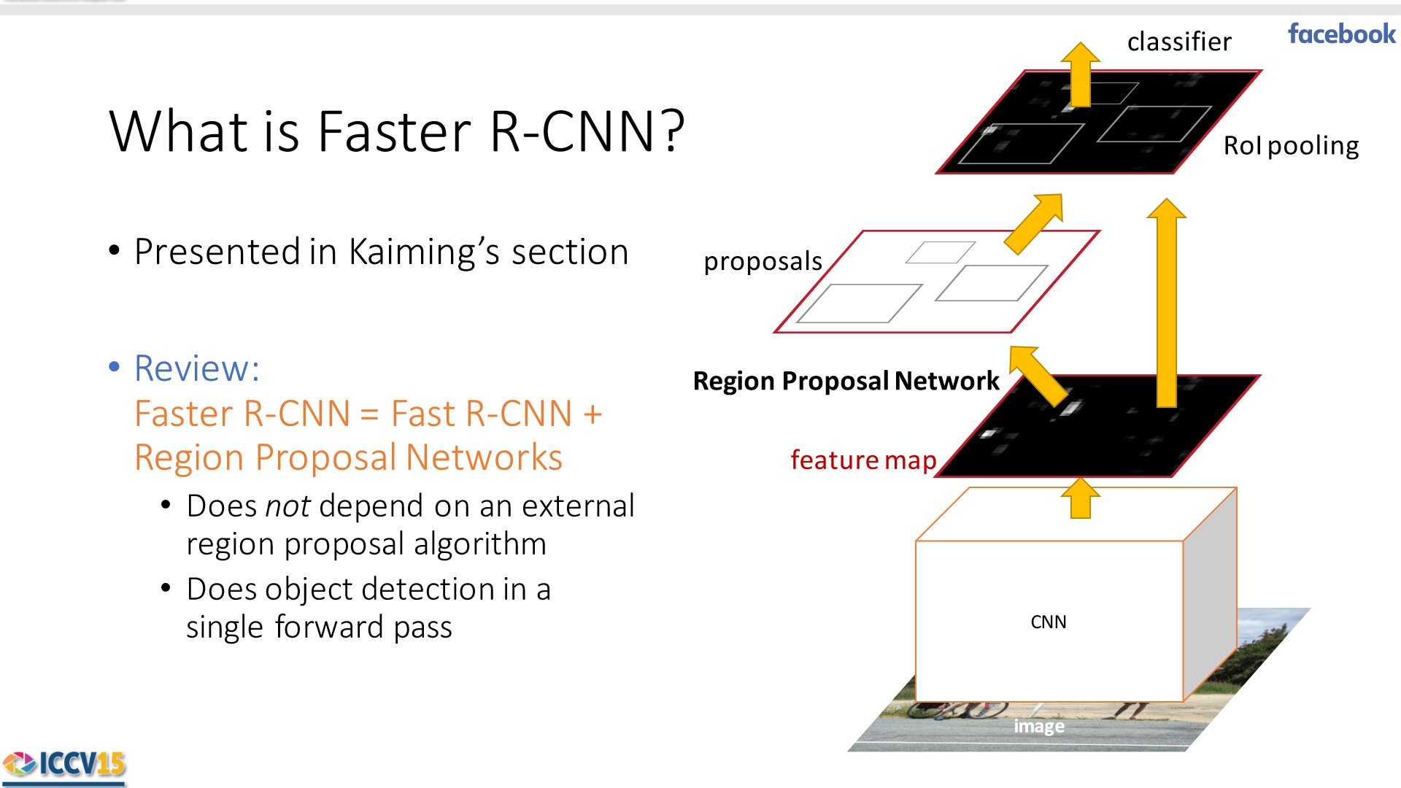

Slide 11
Train the RPN

Slide 12
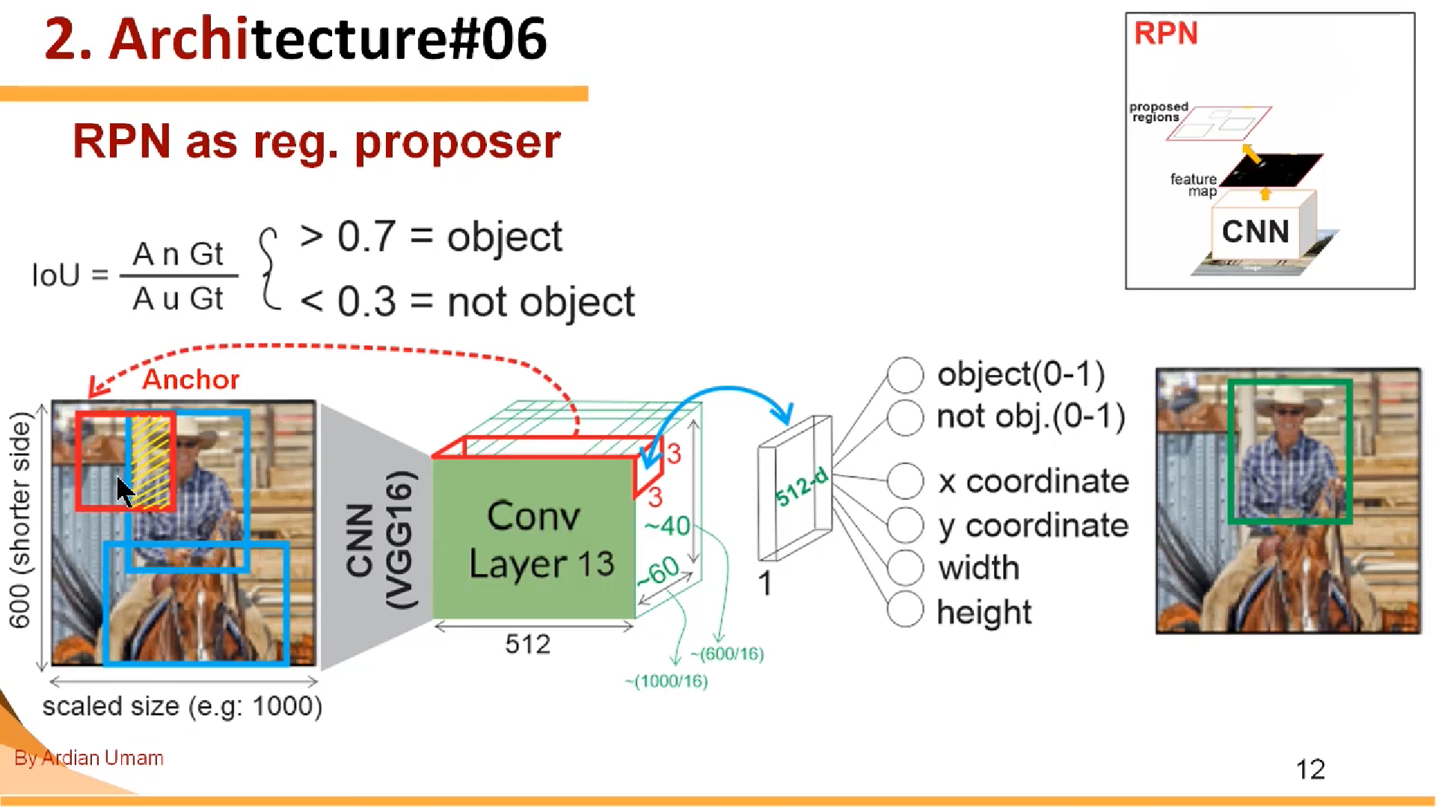

Slide 13
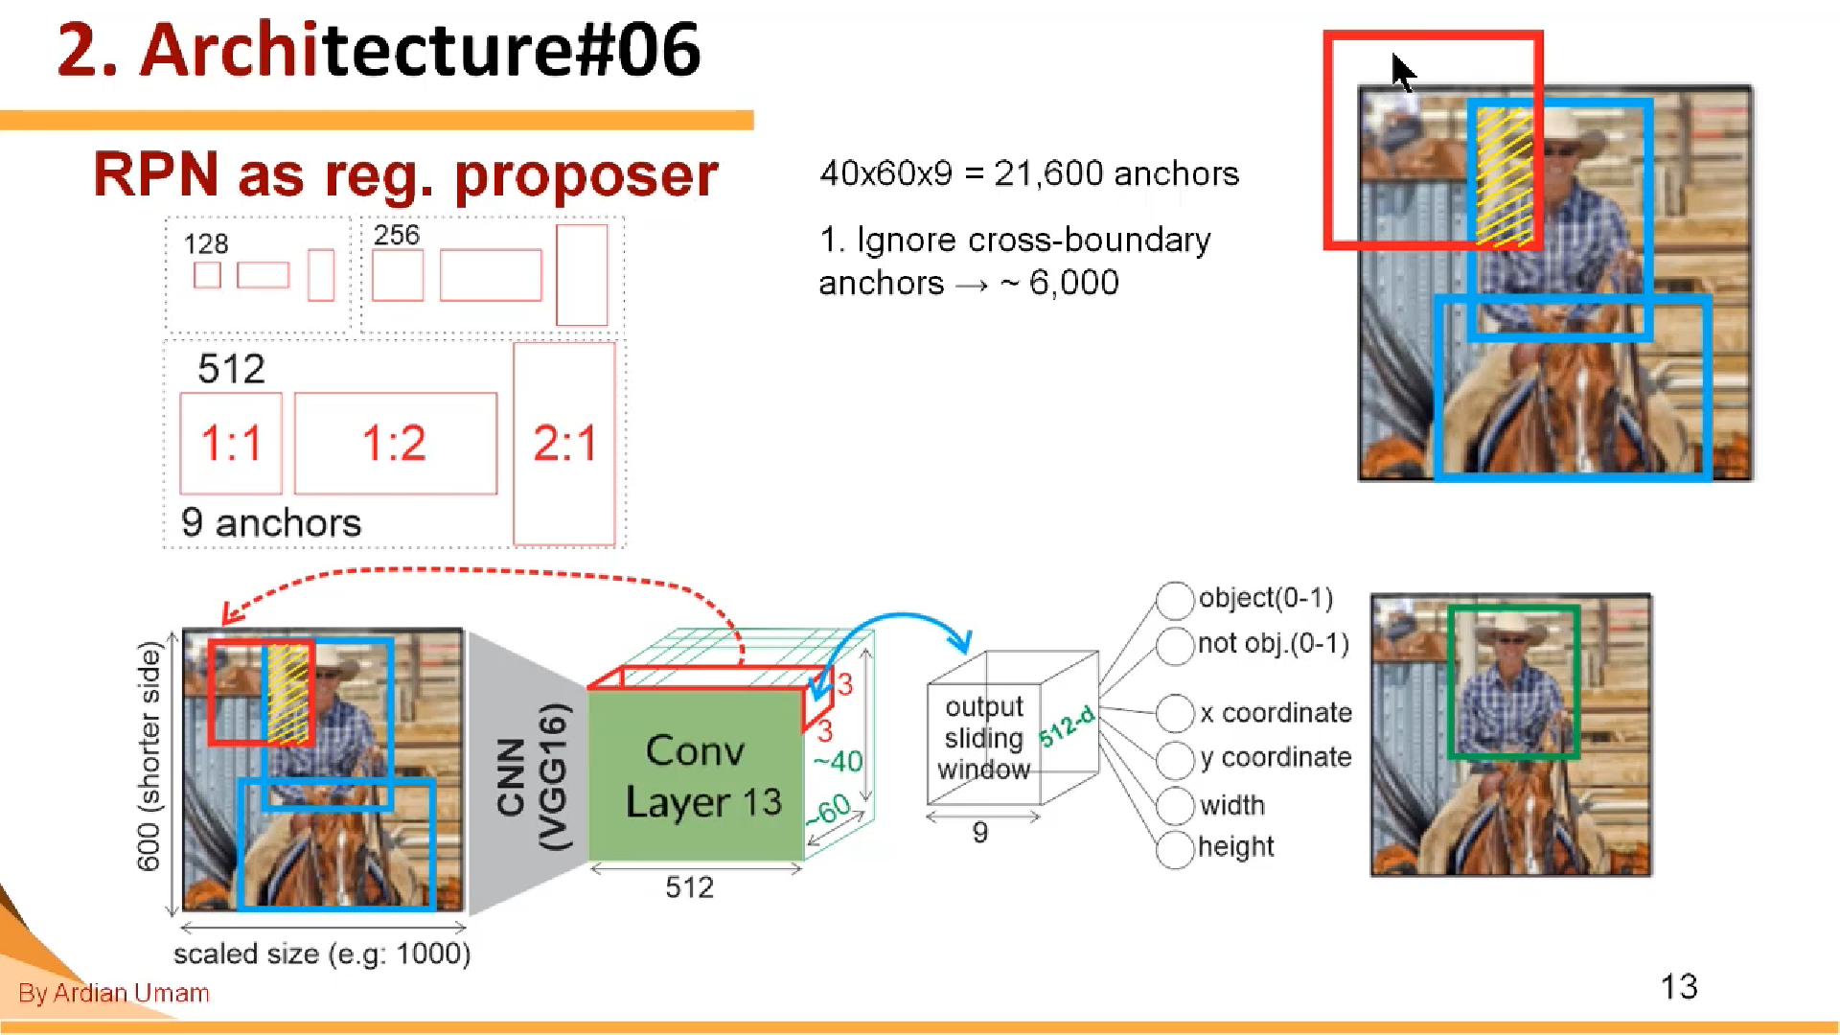

Slide 14
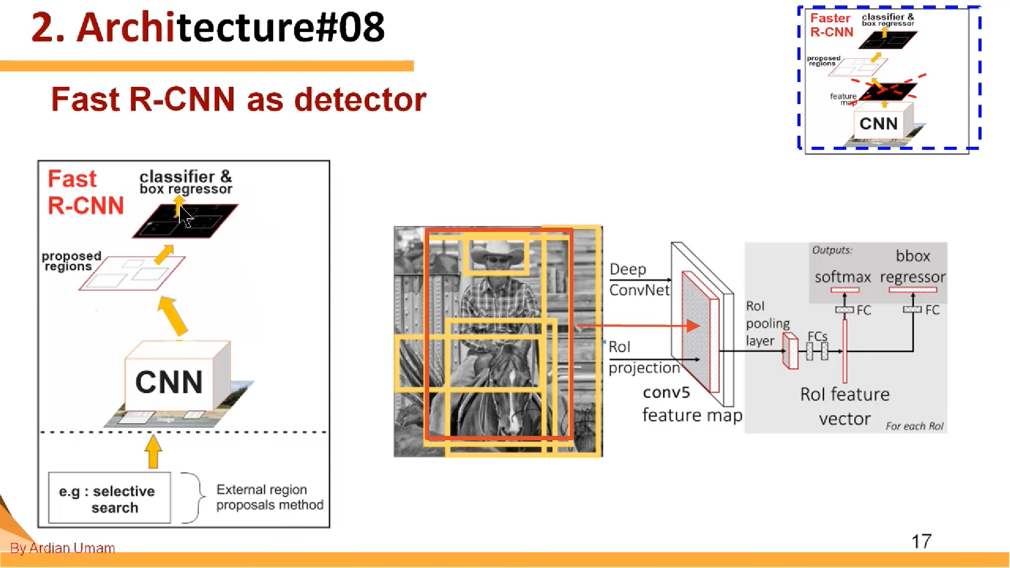

Slide 15
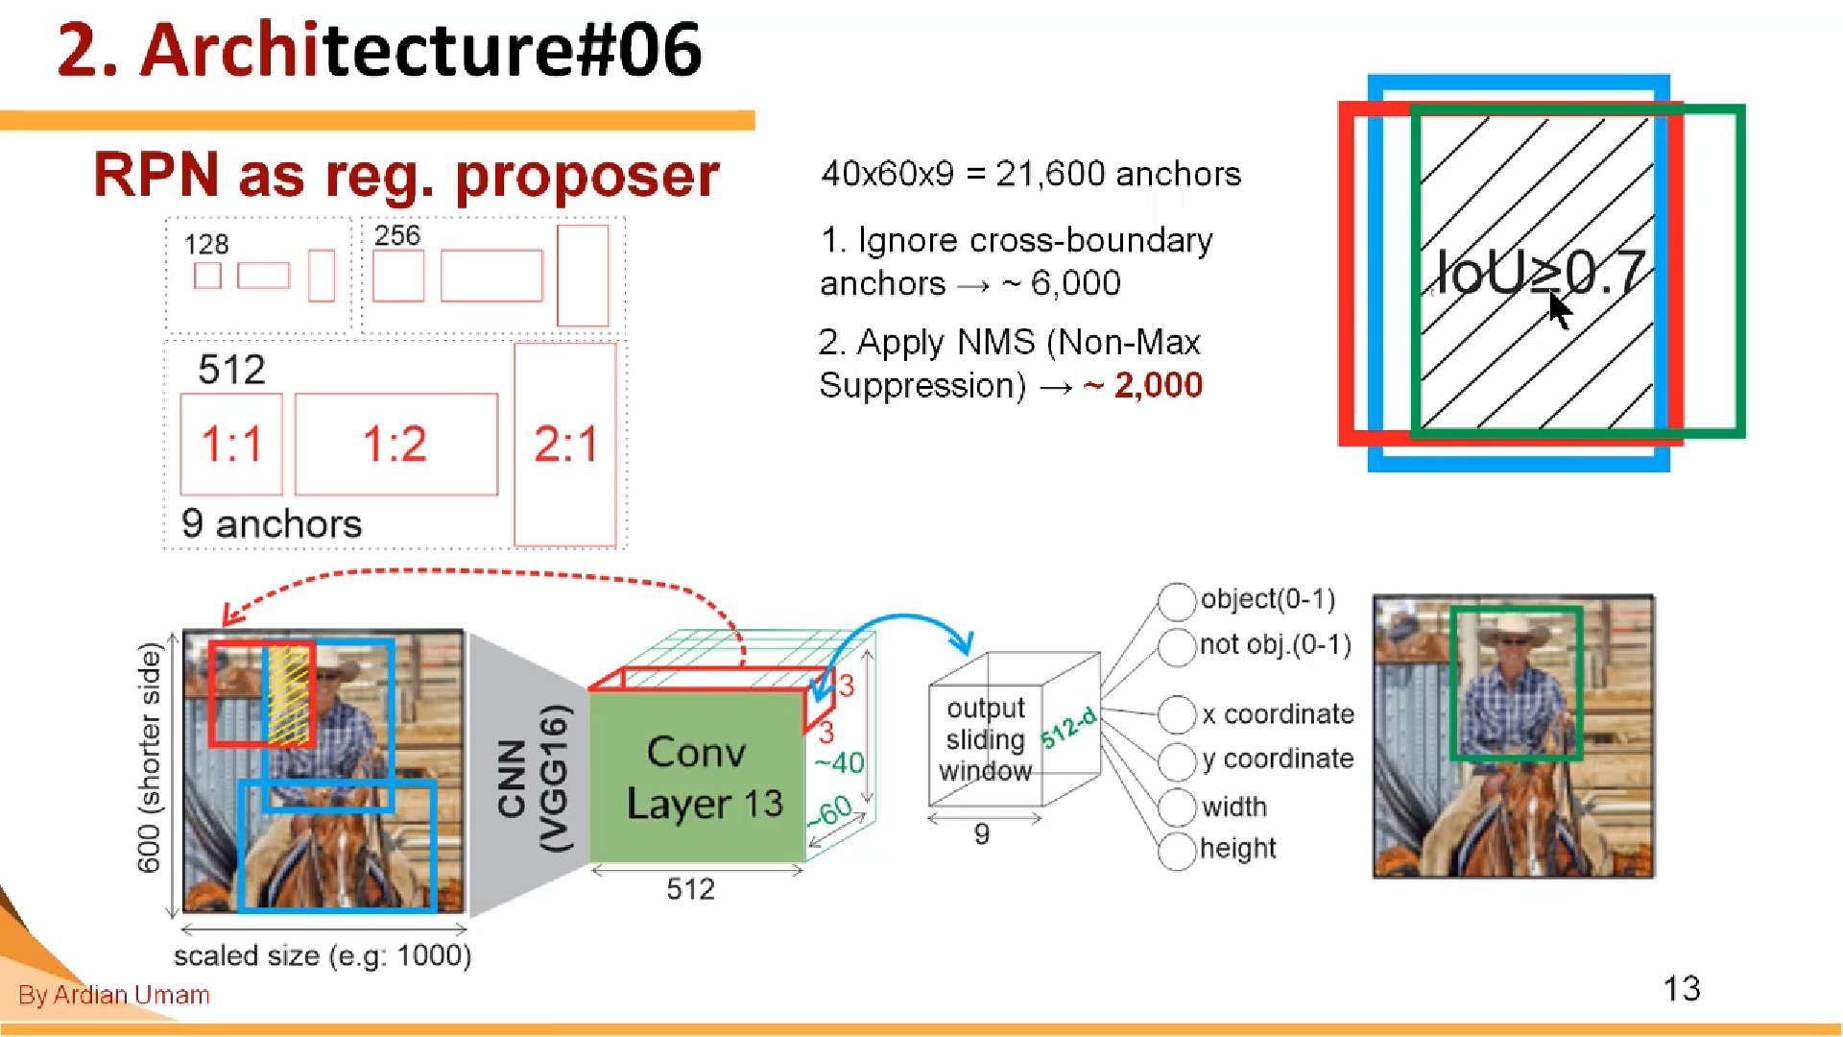

Slide 16
Train the Fast R-CNN

Slide 17
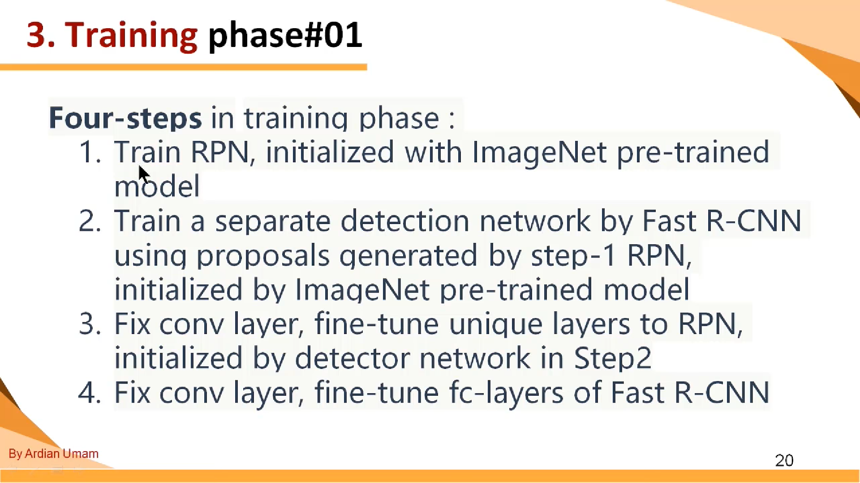

Slide 18
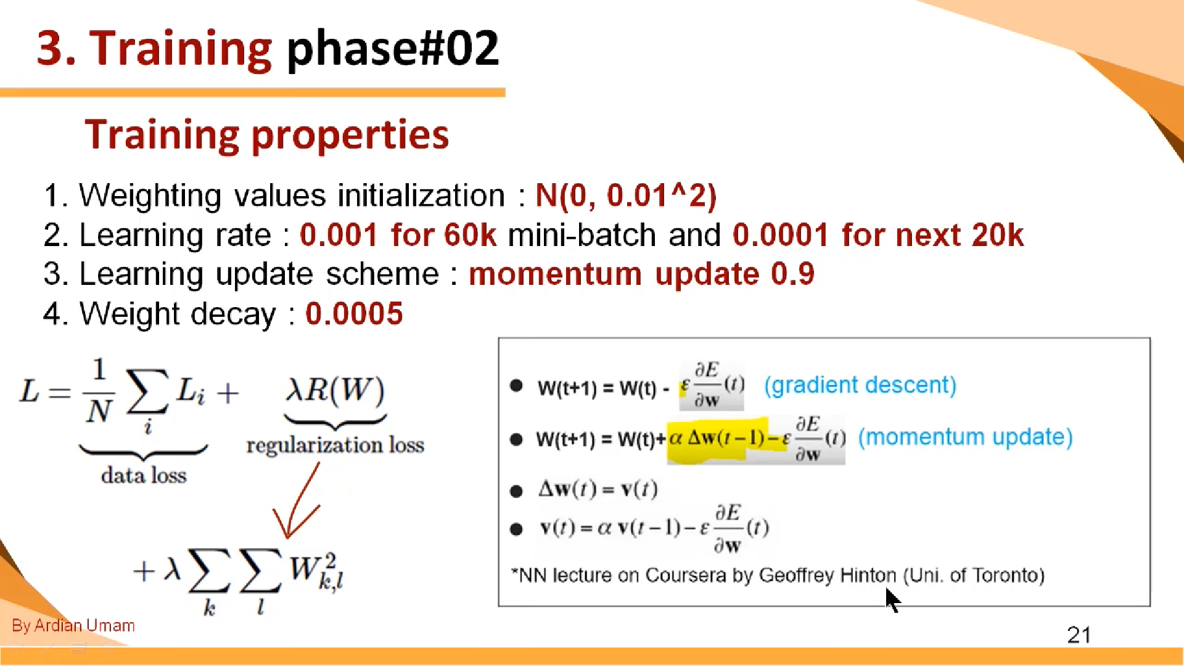

Slide 19
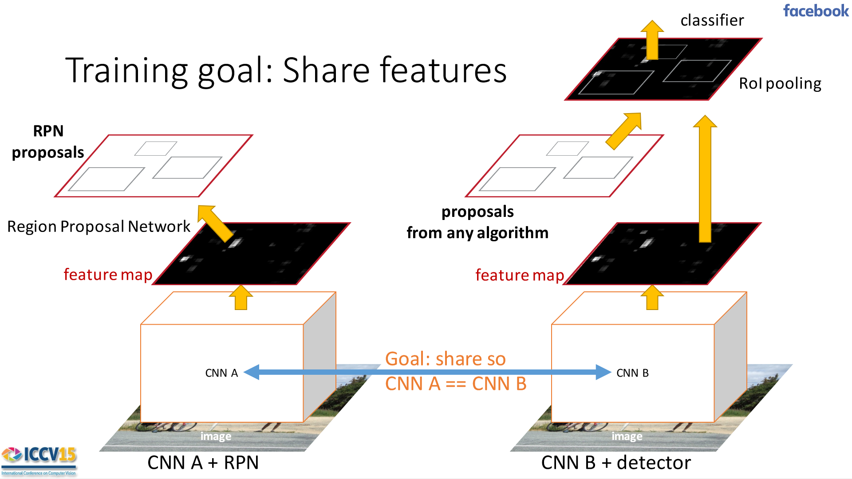

Slide 20
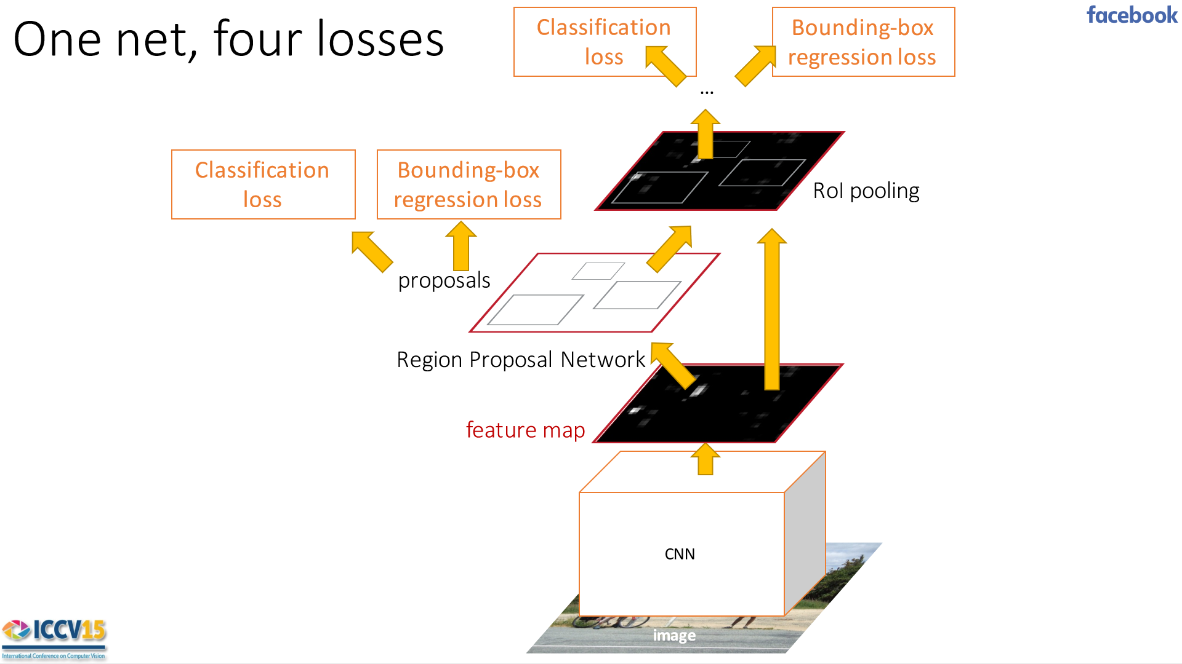

Slide 21
Thanks ☺

